Slide 1
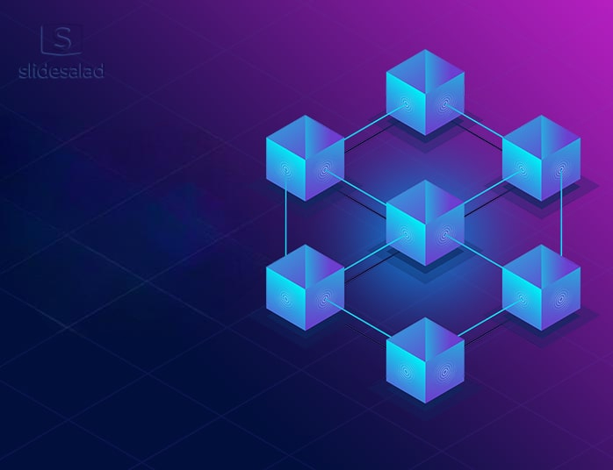
Cross-contract obfuscation and gas optimization framework for solidity smart contract
Guided By
Presented By
S.Aswini ME(CSE)
Harish.N (210221104010)
Manikandan.M (210221104020)
Yokesh.J(210221104040)

Slide 2
Introduction
Smart contracts are essential in blockchain technology as they enable automated and secure transactions without the need for intermediaries. They are widely used in areas like finance, supply chain, and healthcare to streamline processes and ensure transparency. However, they face challenges such as vulnerability to reverse engineering, high gas consumption, and security risks. This project focuses on enhancing security and efficiency through cross-contract obfuscation and reducing gas consumption.

Slide 3
Scope
Enhances security by preventing reverse engineering through cross-contract obfuscation.
Reduces gas costs, making smart contracts more efficient.
Improves intellectual property protection for developers.
Strengthens contract integrity by making code harder to analyze.
Provides a scalable solution for real-world blockchain applications.

Slide 4
Existing System
Current obfuscation techniques focus only on individual contracts.
Available tools increase gas consumption.
Decompilers can still analyze obfuscated contracts.
Limited adoption.

Slide 5
Proposed System
Implement cross-contract obfuscation to secure interactions between linked contracts.
Optimize gas consumption by reducing redundant computations and storage usage.
Ensure minimal impact on contract functionality while improving security and cost efficiency.

Slide 6
Hardware Requirements
Processor: Intel i5 or higher
RAM: 8GB or more
Storage: 250GB minimum
GPU: Recommended for testing and simulation
Software Requirements
Development Tools: Solidity, Python, VS Code.
Testing Tools: Remix.
Blockchain Network: Ethereum testnet for deployment.

Slide 7
LITERATURE SURVEY
S.No | Author & Year | Title | Contribution | Advantage | Disadvantage
1 | Zhang et al(2023) | BiAn: Smart Contract Source Code Obfuscation | Source-level obfuscation to increase complexity and resist decompilation. | +174% complexity, -40.5% decompilation success. | +82% gas cost.
2 | Zhang.W, Wang, H., & Xu, J(2023) | Bytecode Obfuscation for Smart Contracts | Bytecode-level obfuscation to counter decompilation with minimal gas impact. | Strong anti-decompilation, low gas overhead. | Hard to maintain/update.

Slide 8
LITERATURE SURVEY
S.No | Author & Year | Title | Contribution | Advantage | Disadvantage
3 | Kondo.Y, Nakamura(2022) | Proposed a dynamic dispatch-based obfuscation technique to hide function signatures. | Hides function signatures via dynamic function dispatch. | Uses blockchain-based one-time programs. | High computational cost.
4 | Xue et al(2023) | Cross-Contract Static Analysis for Detecting Practical Reentrancy Vulnerabilities in Smart Contracts | Developed a static analyzer using symbolic execution to detect reentrancy across interacting contracts. | Accurate detection in multi-contract systems. | False positives/negatives in complex cases.

Slide 9
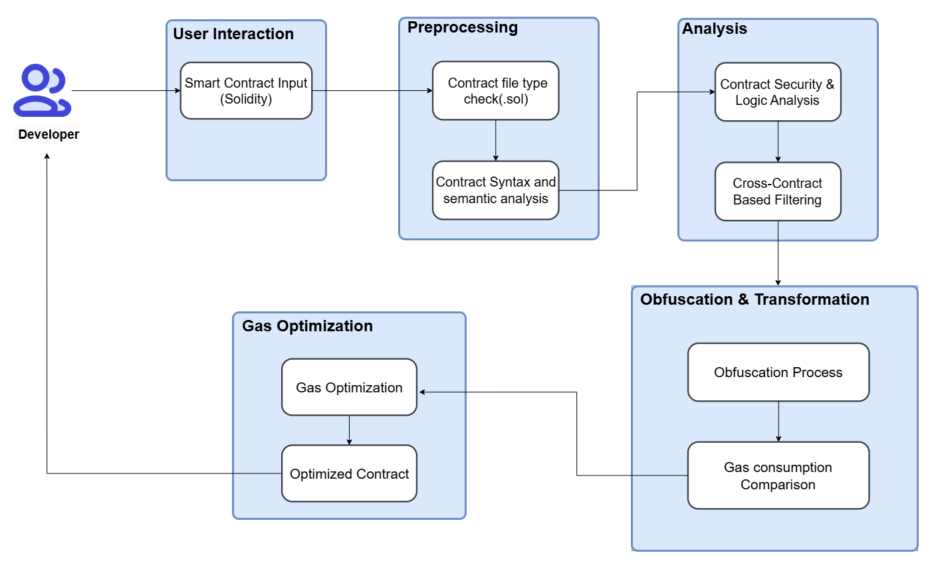
Architecture Diagram

Slide 10
List Of Modules
1.Smart Contract Preprocessing
Accepts Solidity contracts and perform syntax and semantic analysis.
2.Interaction & Logic Analysis
Detects Interaction and logic in contracts.
Filters cross-contract interactions.
3.Obfuscation & Transformation
Applies obfuscation techniques .
Analyzes gas consumption before and after transformation.
4.Gas Optimization
Refines obfuscated code to reduce gas costs while maintaining security.
Outputs a secure, obfuscated, and gas-optimized smart contract.

Slide 11
Module Description
1. Smart Contract Preprocessing
File Type Check: Verifies if the uploaded files are Solidity-based (.sol). Invalid file types are automatically rejected with appropriate error messages.
Syntax Analysis: Performs basic syntax analysis to ensure the code structure.
Semantic Analysis: Utilizes Solidity Abstract Syntax Tree (AST) to extract contract components and check the meaning of the code.
.

Slide 12
Module Description
2. Interaction & Logic Analysis
Interaction & Logic Detection: Detects cross-contract interactions using static analysis.
Interaction Filtering: Cross-contract interactions are filtered by generating a JSON configuration file that maps interactions to specific obfuscation techniques.

Slide 13
Module Description
3. Obfuscation & Transformation
Obfuscation Applied:
High-level call obfuscation.
Low-level call obfuscation.
Proxy pattern obfuscation.
Factory based deployment obfuscation.
Execution: Obfuscation applied based on JSON configuration.
Gas Consumption Analysis: Gas usage is analyzed before and after obfuscation using Static analysis technique, chosen for its comprehensive coverage and ease of use with Solidity projects.

Slide 14
Module Description
4. Gas Optimization
Optimization Level: Bytecode-level optimization.
Techniques Used: Storage Packing (Optimized Slot Usage), Precomputed Function Selector Dispatching, Optimized Memory Handling (Minimal Stack Moves)
Process: Automatically refines obfuscated contracts to reduce gas costs while preserving security.
Output: Secure, obfuscated, and gas-optimized smart contract.

Slide 15
References
[1] Zhang, Y., Li, Y., Wang, S., & Liu, Y. (2023). BiAn: Smart Contract Source Code Obfuscation. IEEE Transactions on Software Engineering.
[2] Zhang, W., Wang, H., & Xu, J. (2023). Bytecode Obfuscation for Smart Contracts. IEEE Transactions on Dependable and Secure Computing.
[3] Kondo, Y., Nakamura, T., & Tanaka, K. (2022). Smart Contracts Obfuscation from Blockchain-based One-time Program. IACR Cryptology ePrint Archive.
[4] Xue, R., Zhang, L., & Lu, X. (2020). Cross-Contract Static Analysis for Detecting Practical Reentrancy Vulnerabilities in Smart Contracts. IEEE Transactions on Dependable and Secure Computing.
[5] Kumar, K. A., Verma, A., & Kumar, H. (2022). Smart Contract Obfuscation Technique to Enhance Code Security and Prevent Code Reusability. International Journal of Mathematical Sciences and Computing, 8(3), 30–36.DOI: 10.5815/ijmsc.2022.03.03
[6] Ebrahimi, A. M., Adams, B., Oliva, G. A., & Hassan, A. E. (2024). A Large-Scale Exploratory Study on the Proxy Pattern in Ethereum. Empirical Software Engineering, 29(1), Article 10485. DOI: 10.1007/s10664-024-10485-1 ACM Digital Library

Slide 16
Thank You

